Slide 1
Sepsis Prediction via Physicians’ Notes
Ameet Chaubal, Nirave Kadakia,
Georgia Institute of Technology, Atlanta, GA

Slide 2
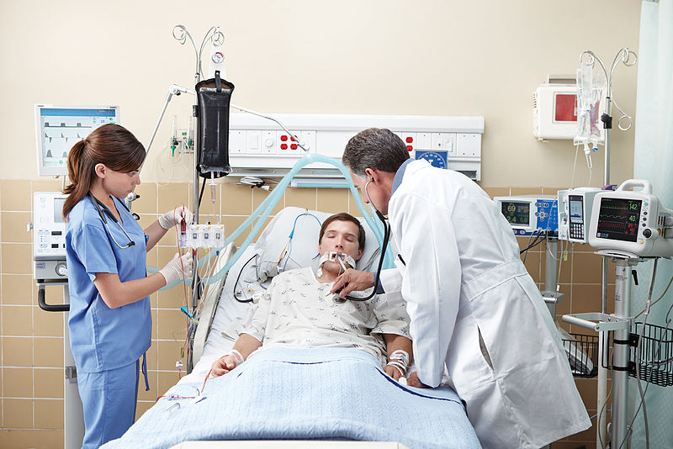
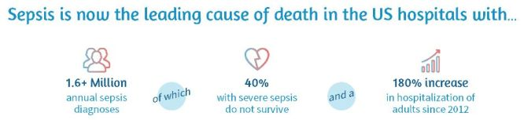
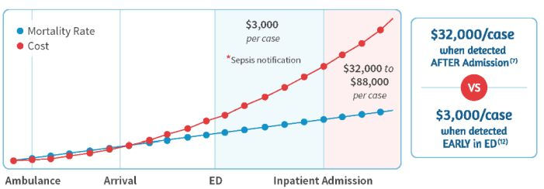
SEPSIS – Expensive and Deadly
Fig 1: Sepsis leading cause of death src: https://www.intermedix.com/
Fig 2: Financial cost of Sepsis, src: https://www.intermedix.com/
Notes:
Sepsis can be plain and simply described in one word – deadly. Sepsis, where the body’s response to infection further injures tissues and organs, is the number of killer in hospitals. 1.6 million diagnosis per year, at a death rate of 40% and a resultant significant increase in hospitalization.
Needless to say, identifying and treating it before symptoms become apparent is crucial to survival.
In addition, Sepsis has huge financial ramification. Early detection of sepsis costs approximately $3000 – in contrast, not detecting it early costs $32000.
This presentation will detail an approach that allows early Sepsis prediction with good accuracy and can help predict impending cases of Sepsis upon hospital admission, thus potentially saving lives and reducing significant financial burden.

Slide 3
SEPSIS PREDICTION – PREVIOUS RESEARCH
LDA + Clustering =>
Sepsis Prediction
DeSautels
Ghassemi
Mortalitly prediction
30 day – 1 year post discharge
Via free text notes
AUCs range 0.85-0.77
Sepsis prediction
Using ML “Insight”
Improvement on qSOFA
24-48 discharge
Notes:
Two major pieces of research were explored when determining the approach.
One paper, titled “Prediction of sepsis in the intensive care unit with minimal electronic health record data: A machine learning approach” by Desuatels and others used machine learning techniques to identify patients with sepsis.
The most important is Unfolding physiological state: mortality modeling in intensive care units by Ghassemi and others. This basically predicted mortality based on Physician notes 30 days to 1 year post discharge using Physician notes.
Our model basically Ghassemi’s method of using Physician's notes with unsupervised learning to predict whether a patient, within the MIMIC-III data, will later be diagnosed with Sepsis diagnosis.

Slide 4
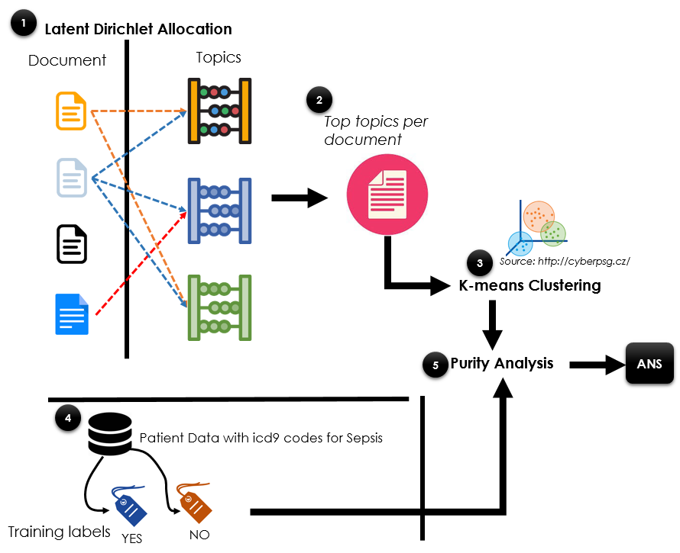
SEPSIS PREDICTION – APPROACH
Algorithm
1. LDA
Preform analysis on all Physician notes
2 Top Topics
Identify identifying topics for docs
3 K-means Clustering
Cluster into 2 clusters
4. Training Labels
Assign Sepsis output for patients
5. Purity Analysis
Compare how effectively clusters match up with actual labels
Notes:
The approach is broken down into 5 steps
For step 1, using MIMC-III’s information, and big data technologies of YARN and Spark, we perform Latent Dirichlet Allocation, or LDA, to generate topics. Spark, scheduled through YARN, is used to gather information in a distributed manner as our approach is meant for large data that can encompass multi-node storage.
LDA topics, are, in essence, a collection of words that are truly representative of a document, meaning that the words are unique to a physician’s notes and are unique.
In step 2, the top topics are identified for each document and are used as the features for machine learning
In step 3, K-means, an unsupervised learning method, is used to divide the patients into 2 different clusters. The hypothesis is that the clusters will map to the sepsis and non-sepsis suffering patients.
These leads to step 4, which identifies patients into sepsis and non-sepsis patients so that we can compare those with the K-means clusters. While there are many ways to go about Sepsis labeling, a simplistic approach of identifying select Sepsis ICD codes is used.
Finally, the clusters are set, and the inputs are labelled. This will be done through the standard cluster criteria calculation called purity.

Slide 5
Data Preparation
Data preparation using Postgres
Group free text notes by patient
Replace ‘carriage return/new line’ with space

Slide 6
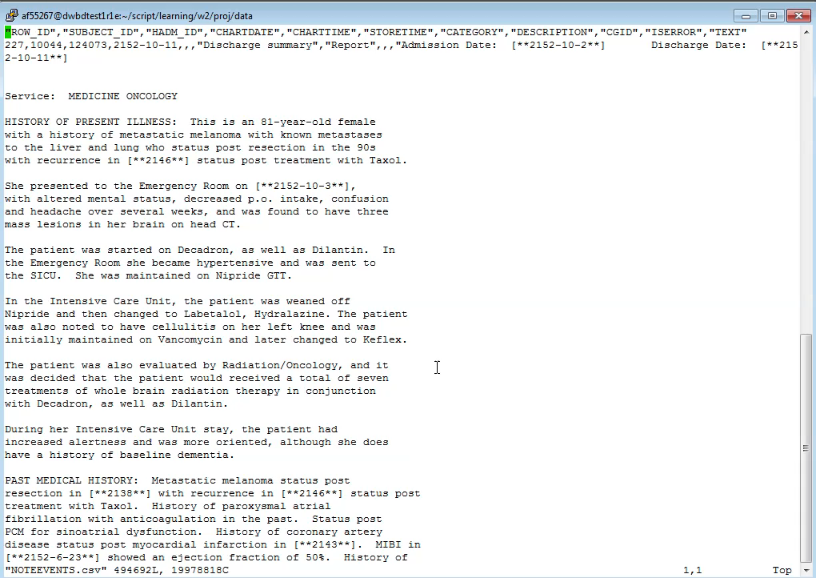

Slide 7
Latent Dirichlet Allocation
Run LDA Analysis

Slide 8
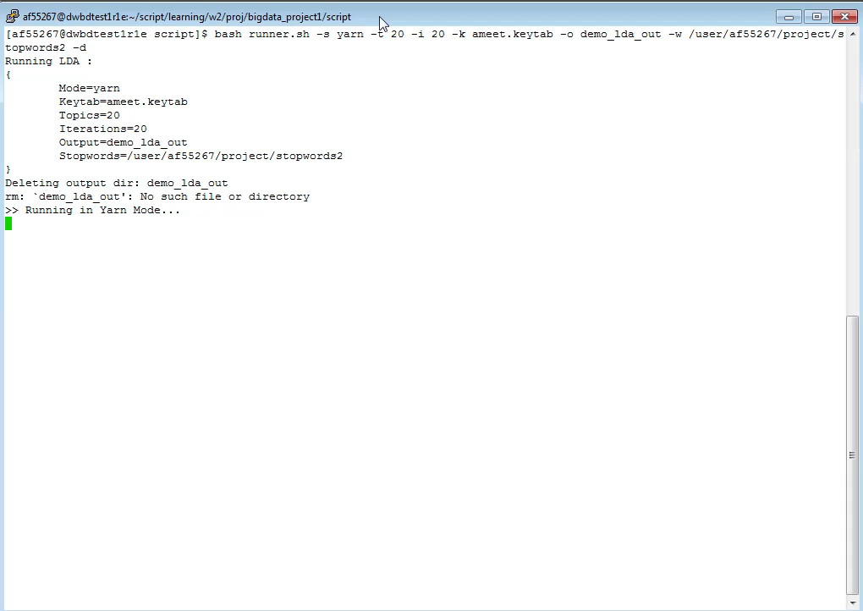

Slide 9
K-means:
Create Subject-Topic Map

Slide 10
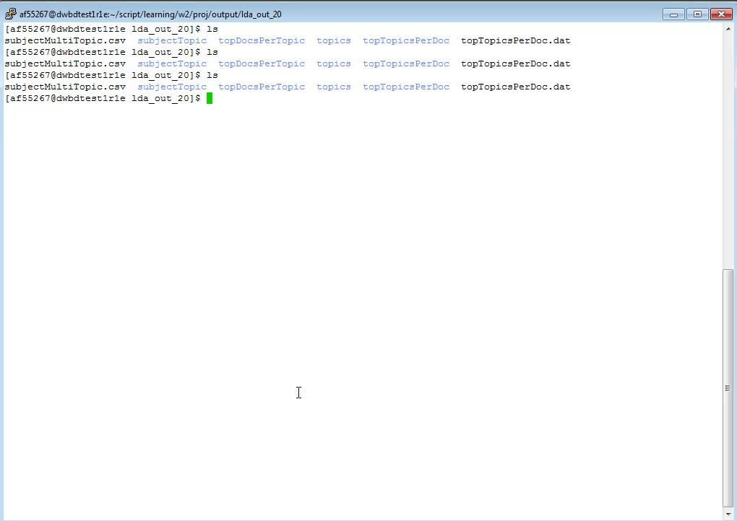
K-Means

Slide 11
K-Means
Create target values for each patient
Run K-means analysis
Calculate Purity

Slide 12
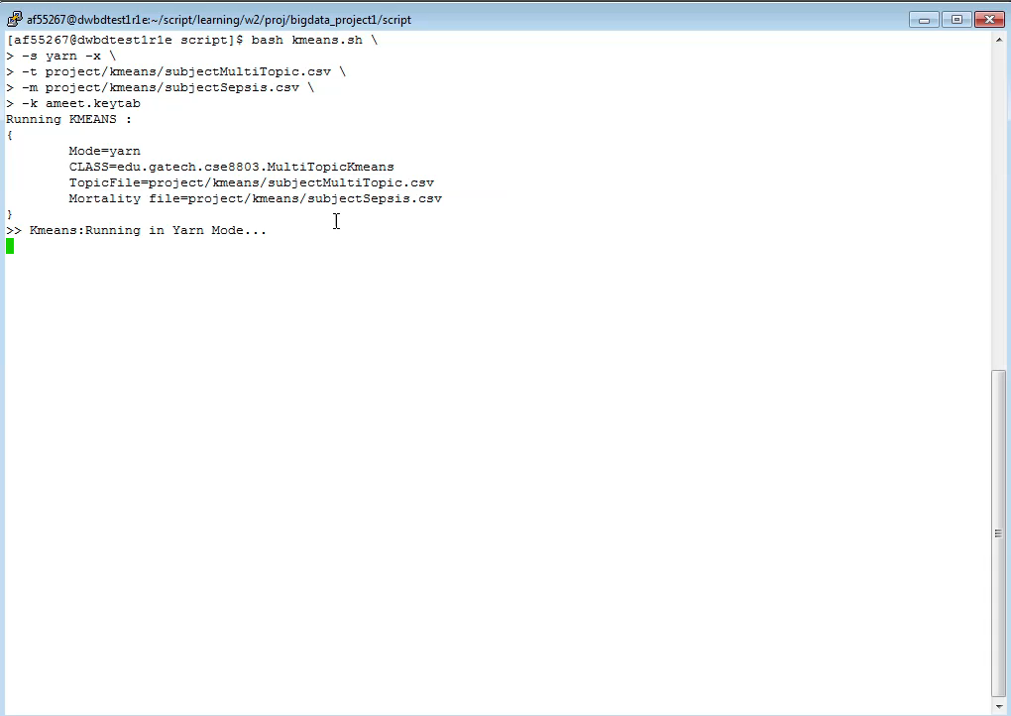
Target Values

Slide 13
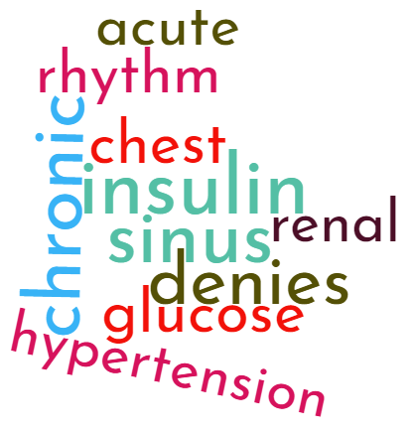
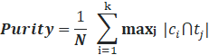
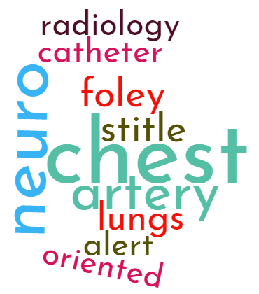
SEPSIS PREDICTION – EXPERIMENTAL RESULTS
Topic | Key Words
TOPIC-1 | neuro, yellow, urine, foley, stool, intubated, social, draining, commands, nursing
TOPIC-2 | cancer, lesion, metastatic, lesions, pelvis, abdomen, radiology, disease, tumor, lymph
TOPIC-3 | Lasix, atrial, heart, cardiac, fibrillation, heparin, Coumadin, rhythm, failure, chronic
TOPIC-4 | respiratory, failure, acute, sounds, pulse, prophylaxis, sputum, nutrition, intubated, ventilation
TOPIC-5 | renal, failure, acute, sepsis, hypotension, dialysis, shock, levophed, infection, catheter
TOPIC-6 | seizure, mental, abuse, alcohol, withdrawal, seizures, ativan, neuro, urine, acute
TOPIC-7 | respiratory, secretions, nasal, received, sounds, bowel, lytes, chest, closely, ordered
TOPIC-8 | trach, secretions, respiratory, sputum, suctioned, tracheostomy, sounds, fentanyl, propofol, sedation
TOPIC-9 | chest, neuro, artery, stitle, foley, lungs, catheter, alert, oriented, radiology
TOPIC-10 | hemorrhage, neuro, frontal, brain, subdural, cerebral, stroke, radiology, hematoma, carotid
TOPIC-11 | fracture, spine, radiology, chest, trauma, fractures, cervical, posterior, injury, vertebral
TOPIC-12 | chest, aortic, artery, coronary, valve, disease, bypass, aorta, graft, stenosis
TOPIC-13 | liver, transplant, hepatic, ascites, cirrhosis, portal, bleed, bleeding, renal, radiology
TOPIC-14 | insulin, sinus, chronic, denies, glucose, chest, acute, rhythm, renal, hypertension
TOPIC-15 | infant, feeds, voiding, murmur, feeding, spells, spits, neonatology, sounds, retractions
TOPIC-16 | chest, abdomen, radiology, abdominal, catheter, bowel, pleural, pelvis, effusion, obstruction
TOPIC-17 | pulse, urine, stool, bleed, abdominal, allergies, bleeding, respiratory, rhythm, prophylaxis
TOPIC-18 | chest, pleural, pneumonia, effusion, pulmonary, radiology, bilateral, pneumothorax, edema, effusions
TOPIC-19 | valve, ventricular, aortic, mitral, leaflets, systolic, mildly, regurgitation, atrium, Doppler
TOPIC-20 | sounds, extremities, respiratory, acute, rhythm, sodium, insulin, nutrition, drains, regular
Purity
0.89968577
Notes:
As seen here, the topics generated through LDA are shown. In addition, word clouds describing two topics in particular, are shown, specifically topic 13 and topic 8. It is quite clear looking at the word cloud, that there are unique and clear descriptions that identify a patient.
Running our algorithm, with K-means of 2 clusters, 2 unique clusters are formed. Running it through the Purity function, the purity calculated is nearly 0.9, indicating very good cluster quality.
In other words, the prediction of a patient being diagnosed with sepsis in the near future after being admitted to a hospital, just using K-means and physicians notes, is quite high – thus proving our hypothesis.

Slide 14
SEPSIS – FUTURE EXPANSION
Better Prediction
Convolutional Neural Networks
Include other inputs (e.g. ICD codes)
Stemming
Modify the Number of Topics
Future Work / Expansion
`
Notes:
While purity remains high at nearly 0.90, further enhancements could be used to further improve accuracy in terms of predicting whether an admitted patient will suffer from sepsis.
As physician’s notes are not succinct or structured. One enhancement to the current model would be the inclusion of stemming to reduce the vocabulary.
Another improvement would be to alter certain hyperparaemeters or other variables, such as the number of topics. With more time, further reduction in topics could result in greater purity.
One key improvement would be the inclusion of other available information from MIMIC-III, such as ICD codes, admission dates, medications, and so forth.
With these inputs, further enhancement of the model could be with the use of Convolutional Neural Networks that can then automatically extract important features automatically and perhaps provide more accurate predictions and/or purity.
In other words, while the purity of prediction is quite accurate, there could be further improvement as time goes on, saving both money and lives.

